Slide 1
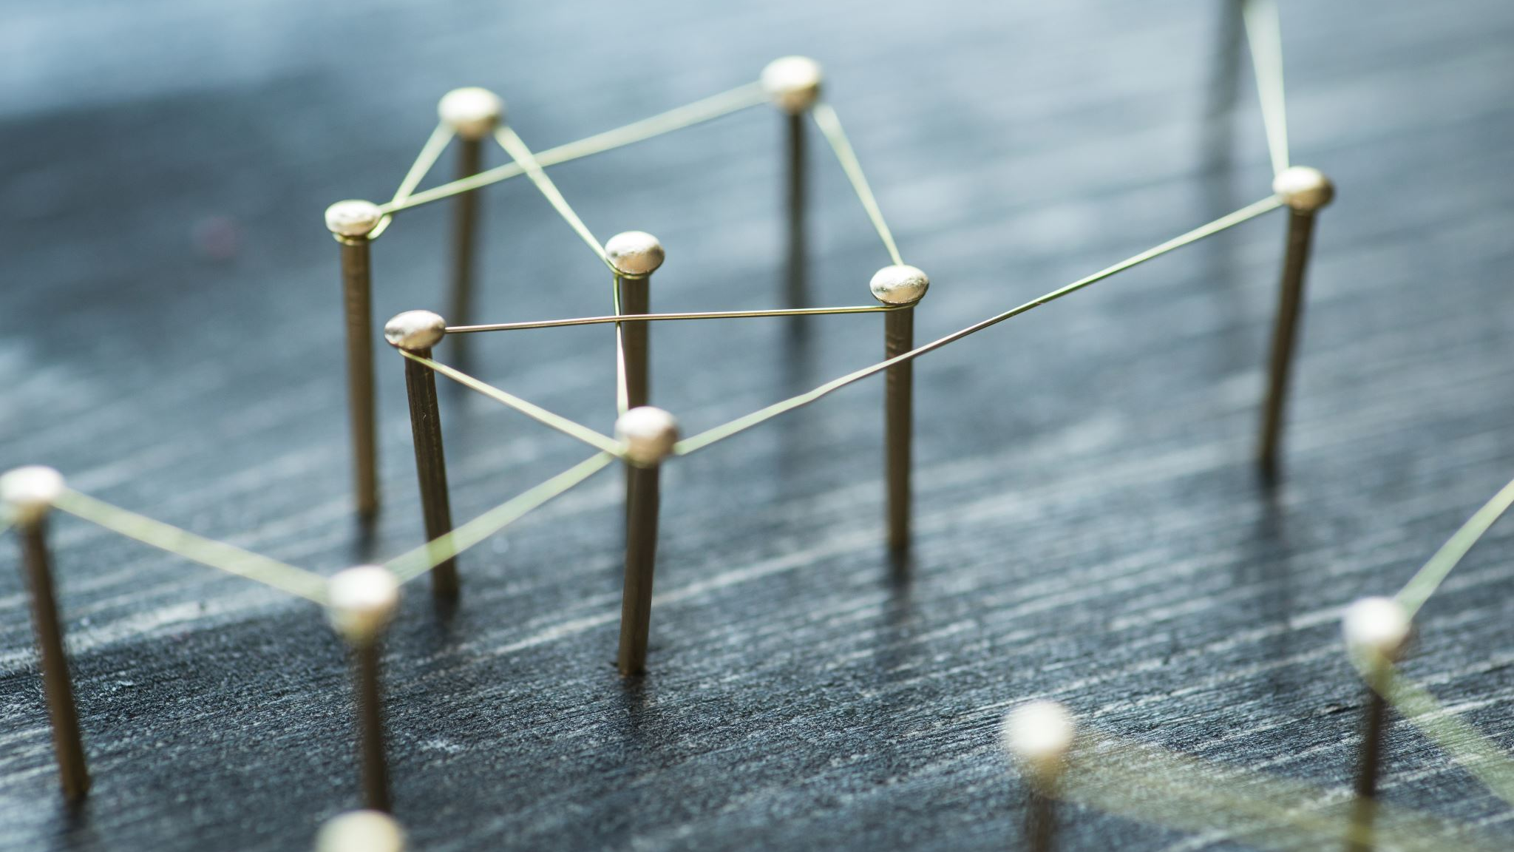
The Internet
What is it, anyway?

Slide 2
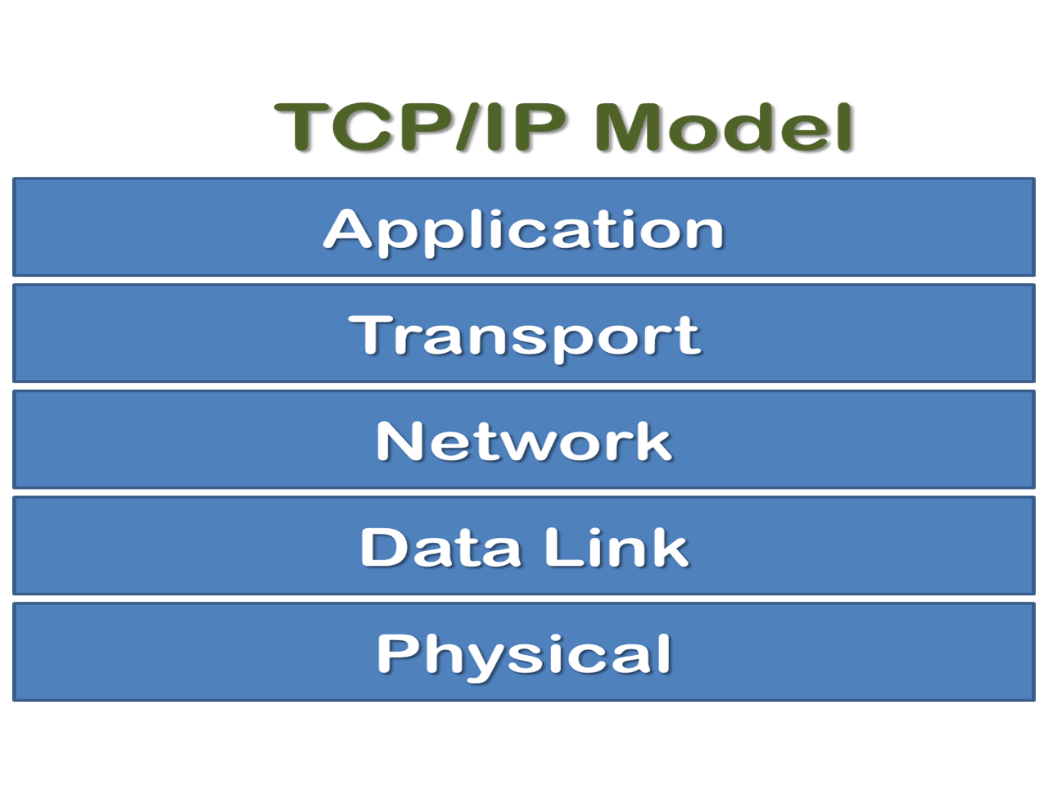
The Basic Idea
Packet Switching
Basic process:
Break up large files into smaller parcels
Transmit them over the internet
Reassemble them at the other end.
The TCP/IP stack is the primary mechanism.

Slide 3
The Stack
We Conceptualize the internet as a layered construct
Each layer is responsible for a part of the process
We go down the stack, and then back up it.

Slide 4
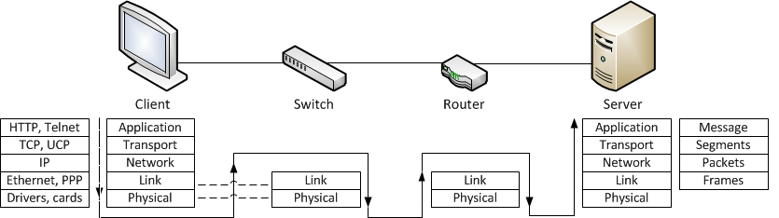
The Journey of a Packet

Slide 5
How does this work for reals?
On a physical level, the internet is constructed of network hardware. Lots of it.
Fable: Internet is this anarchic decentralized network of computers
Reality: Internet is hierarchically constructed of several tiers of networks
Customers
Internet Service Providers
Network Service Providers (Internet Backbone)
Notes:
Each NSP is required to connect to at least three Network Access Points

Slide 6
Anatomy of a URL
https://itech.erickuha.com/book/ch6-internet/what_is_internet.html
https – The protocol
:// - A delimiter
com – Top-level domain
erickuha – Domain name
itech – subdomain
/book/ch6-internet/what_is_internet.html - Path

Slide 7
The internet is going to change
There is a lot of active research going on in network protocols
The fundamental structure of the Internet is constantly evolving
This evolution could kick into high gear soon-ish

Slide 8
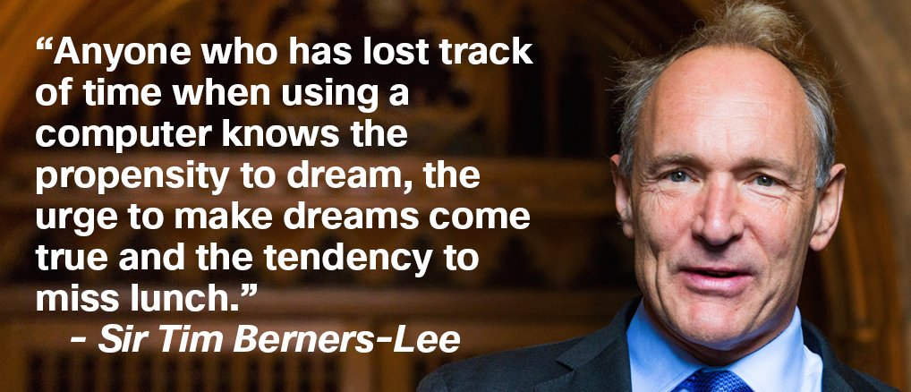
History of the Internet
Check this link

